Slide 1



JOB SATISFACTION
DSO 545 Data Visualization
C9: Cloud 9

Slide 2


TABLE OF
Contents
01
Background & research question
02
Dataset Overview
03
EDA
04
Methodologies & Models
05
Statistical Findings
06
Conclusion
Introduction
DSO 545 - Cloud 9
Page 1 of 10

Slide 3

Background & Research Question
Research Business Question:
What are the factors that drive job satisfaction?
Importance of the Question:
- To create a thriving, high-performing work environment
- To foster employee engagement and retention
- To enhance organizational success and sustainability
Initial Assumptions for Factors:
1. Monthly Income: Impact on financial well-being
2. Distance from Home: Influence on commute stress
3. Company Culture: Affects culture and opportunities
4. Job Security: Key for well-being and productivity
5. Work-life Balance: Reflects work-life dynamics
Introduction
DSO 545 - Cloud 9
Page 2 of 10
Notes:
Hello everyone, we are team C9 and today we are going to discuss about our research and analysis on the factors that drive job satisfaction.
We realized that from a business perspective, it is important to understand the factors that contribute to job satisfaction as it is crucial not just for individual employees but for the success of entire organizations. When employees are satisfied, they’re more engaged, productive, and likely to stay with the company which ultimately leads to a thriving, high-performing work environment that benefits everyone involved. It also leads to better retention rates, reducing turnover costs, and contributing to the long-term sustainability of the organization
Before we began the research, we identified some potential initial assumptions regarding what might influence job satisfaction.
Monthly Income,
Distance from Home
Company Culture,
Job security
And finally, work life balance
Simon will now talk about the dataset we chose to perform exploratory data analysis on in order to get a better understanding of possible factors and their impacts

Slide 4
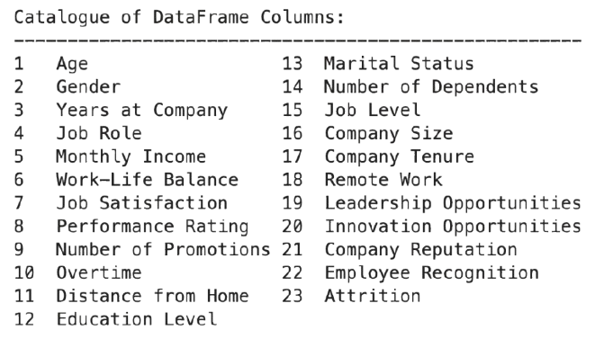
Dataset
Why?
Diversity (Ex. Job Role, Education Level)
Good Quality and Amount of factors (23)
The MOST number of observations. (59598)
Selection
Correlation, Regression, Random Forest
Monthly Income
Work-Life Balance
Distance From Home
Company Size
Marital Status
DSO 545 - Cloud 9
Page 3 of 10

Slide 5
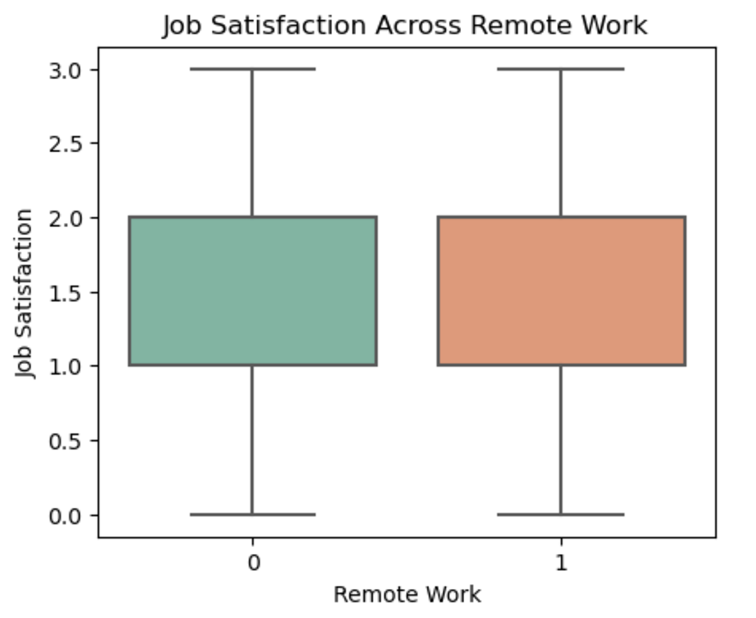
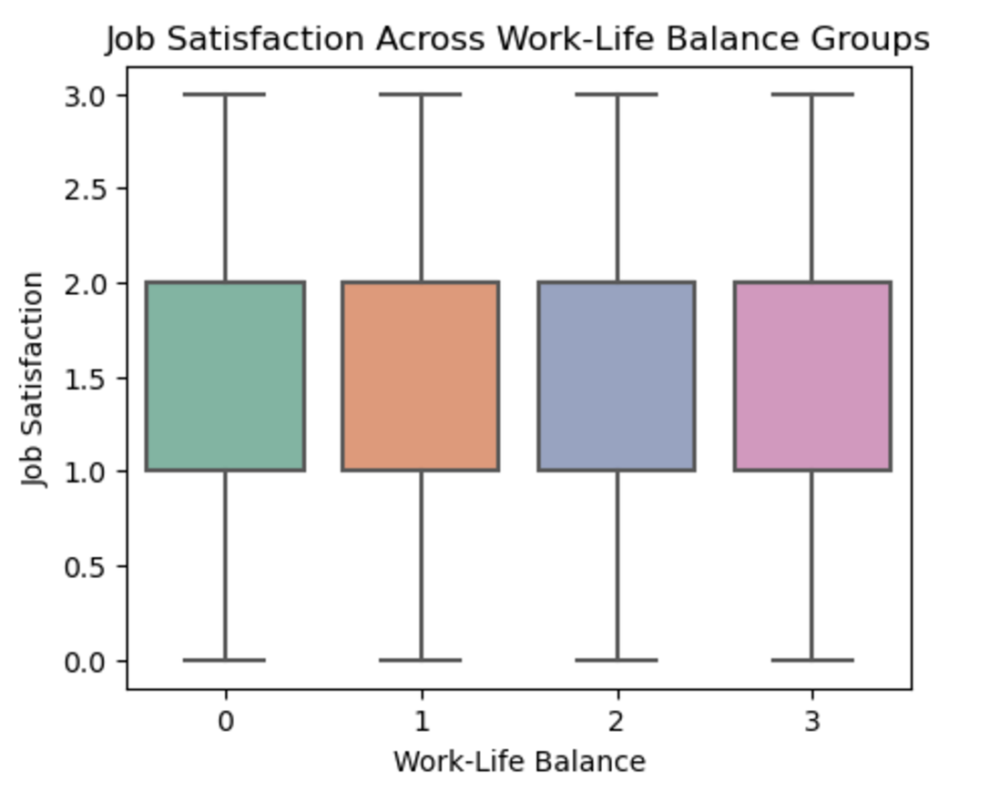
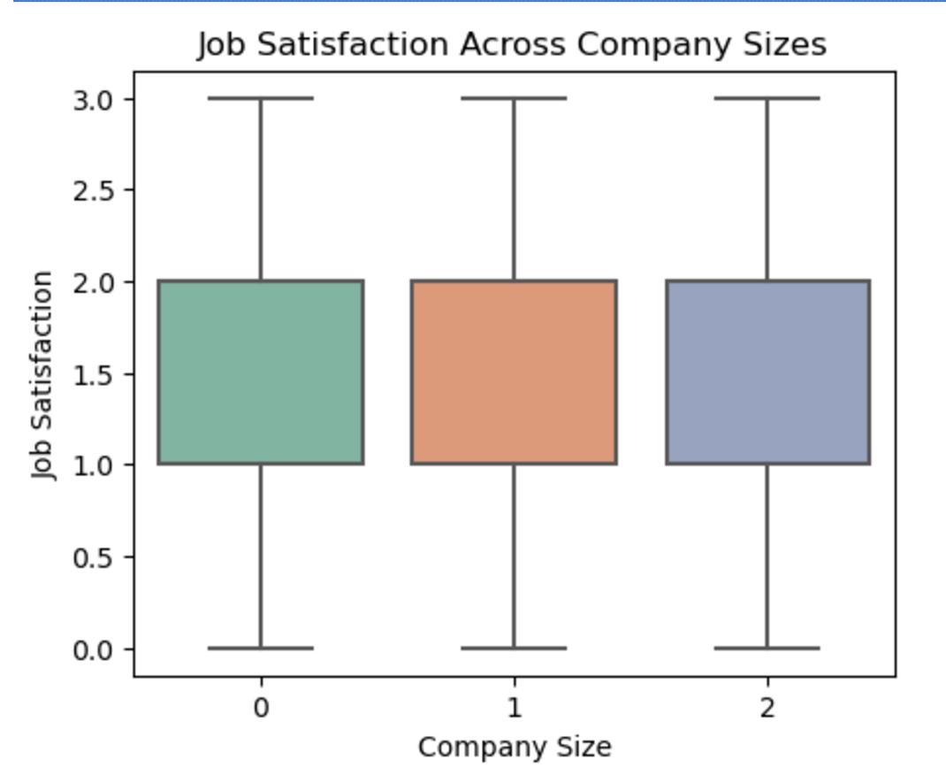
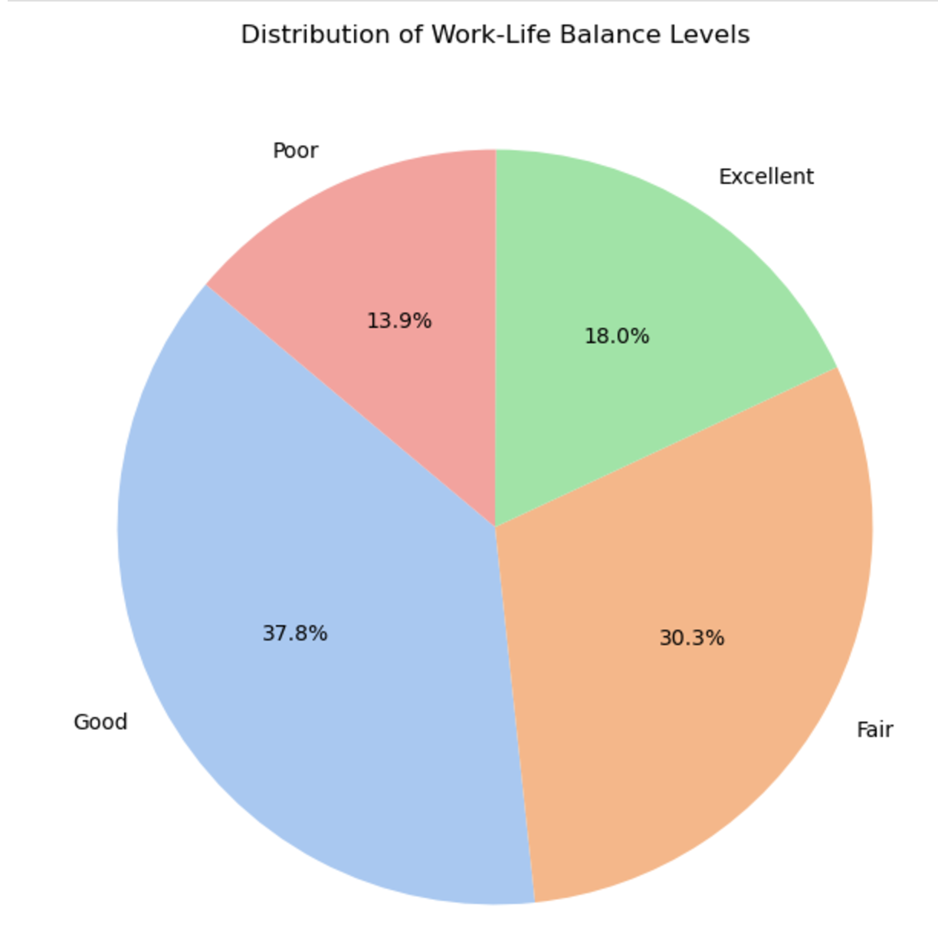
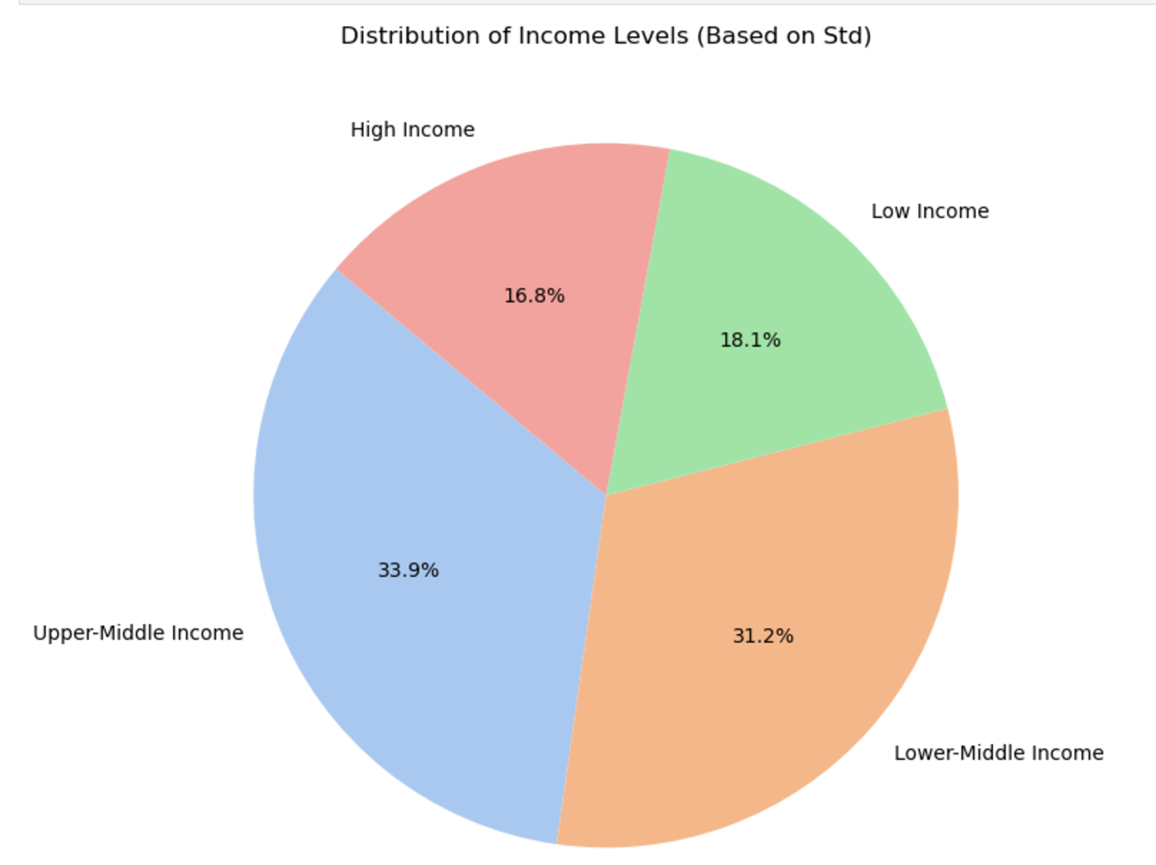
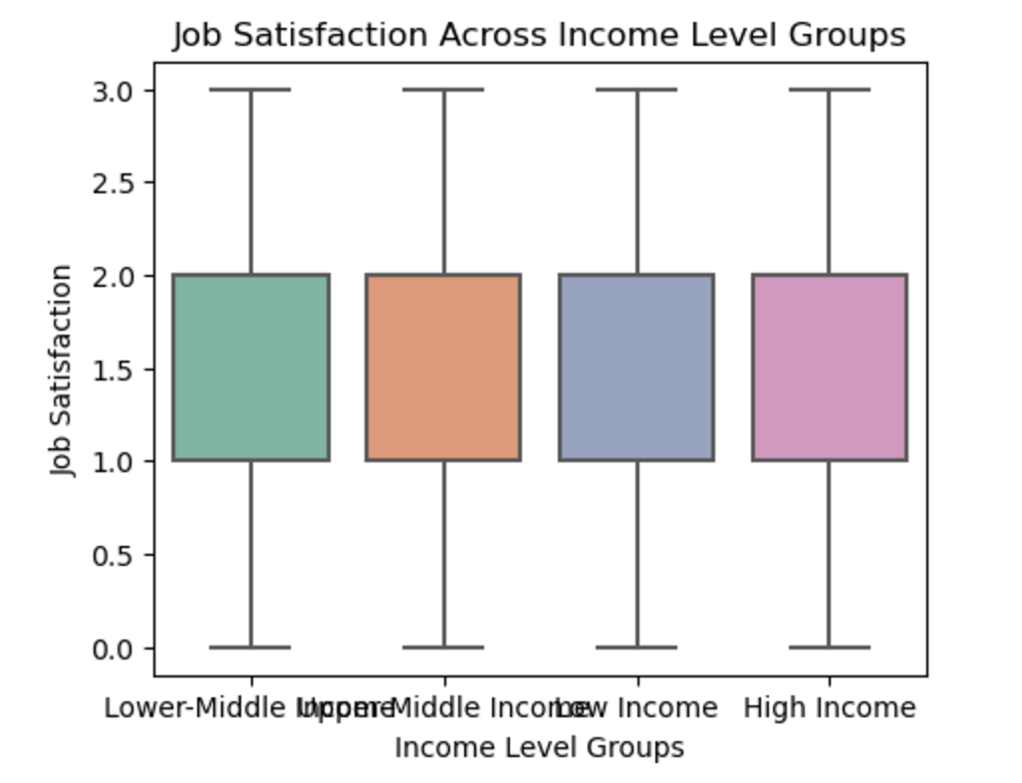
Descriptive Analysis
Satisfaction across different remote work/ WLB/ company size/ income groups are all the same
The similar distribution of suggests a potential relationship. Further analysis of their interaction effect on Job Satisfaction could uncover key insights.
Build a Network
Consistency is Key
EDA
Page 03 of
DSO 545 - Cloud 9
Page 4 of 10

Slide 6
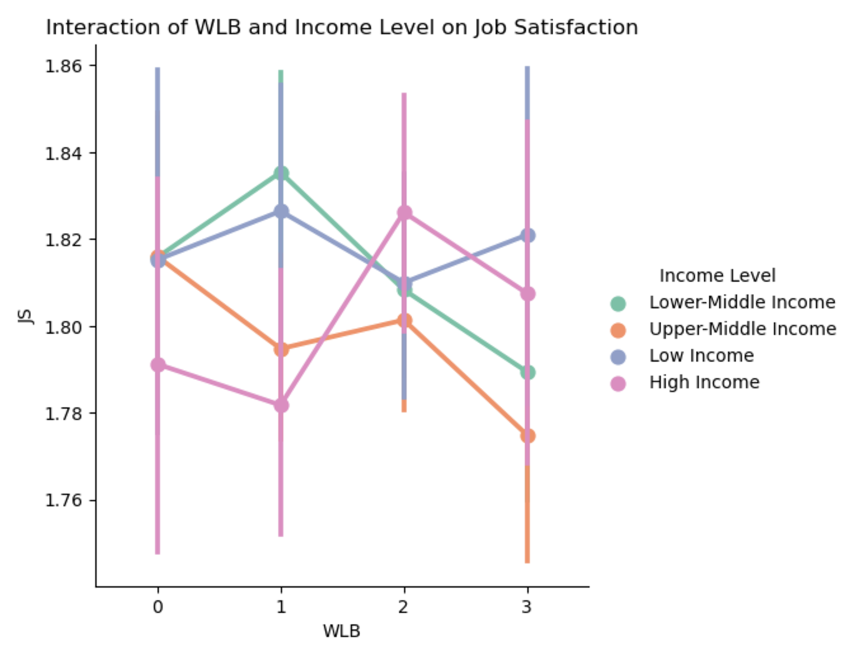
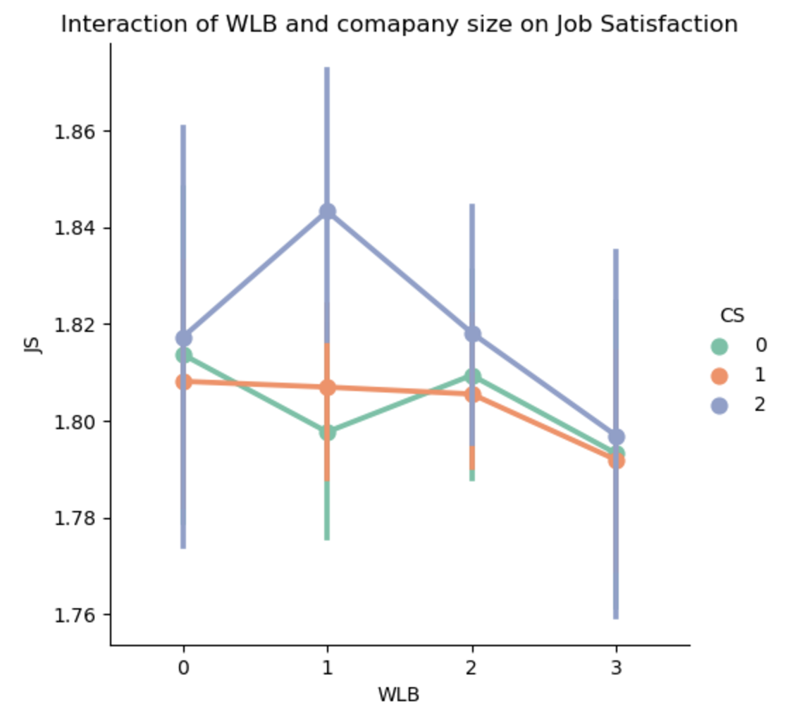
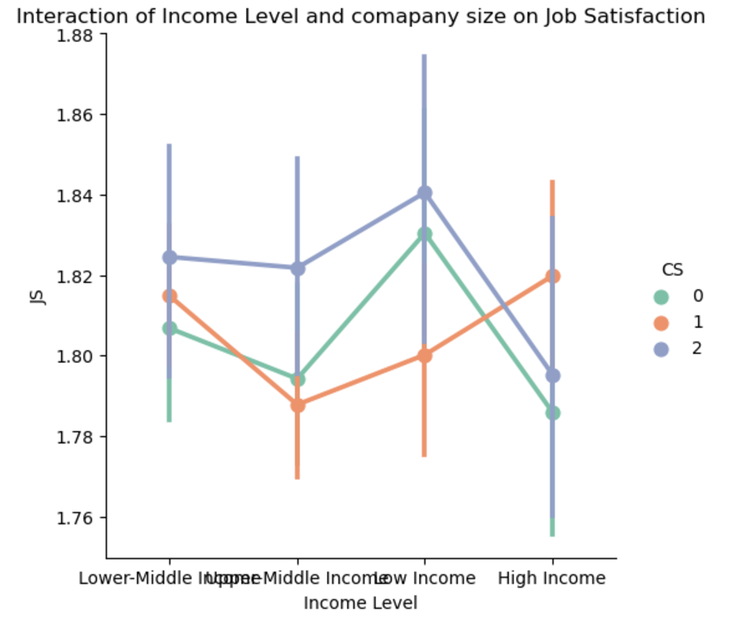
Descriptive Analysis
Income Levels: Some income groups (e.g., high-income individuals) are more sensitive to changes in work-life balance, which could show improving workplace policies may improve job satisfaction.
Company Size: Employees from large companies with higher work-life balance actually have lower satisfaction compared to those who have lower work-life balance.
Employees in large companies (CS = 2) report the highest variability in job satisfaction, especially at the High Income level.
Build a Network
Consistency is Key
EDA
Page 03 of
DSO 545 - Cloud 9
Page 5 of 10

Slide 7
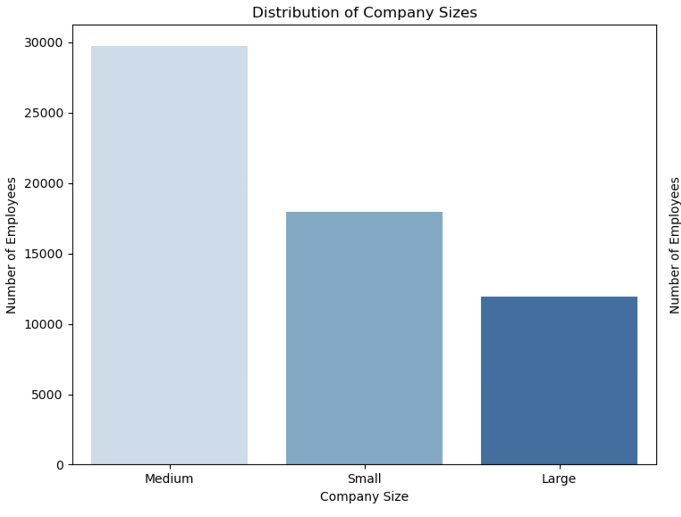
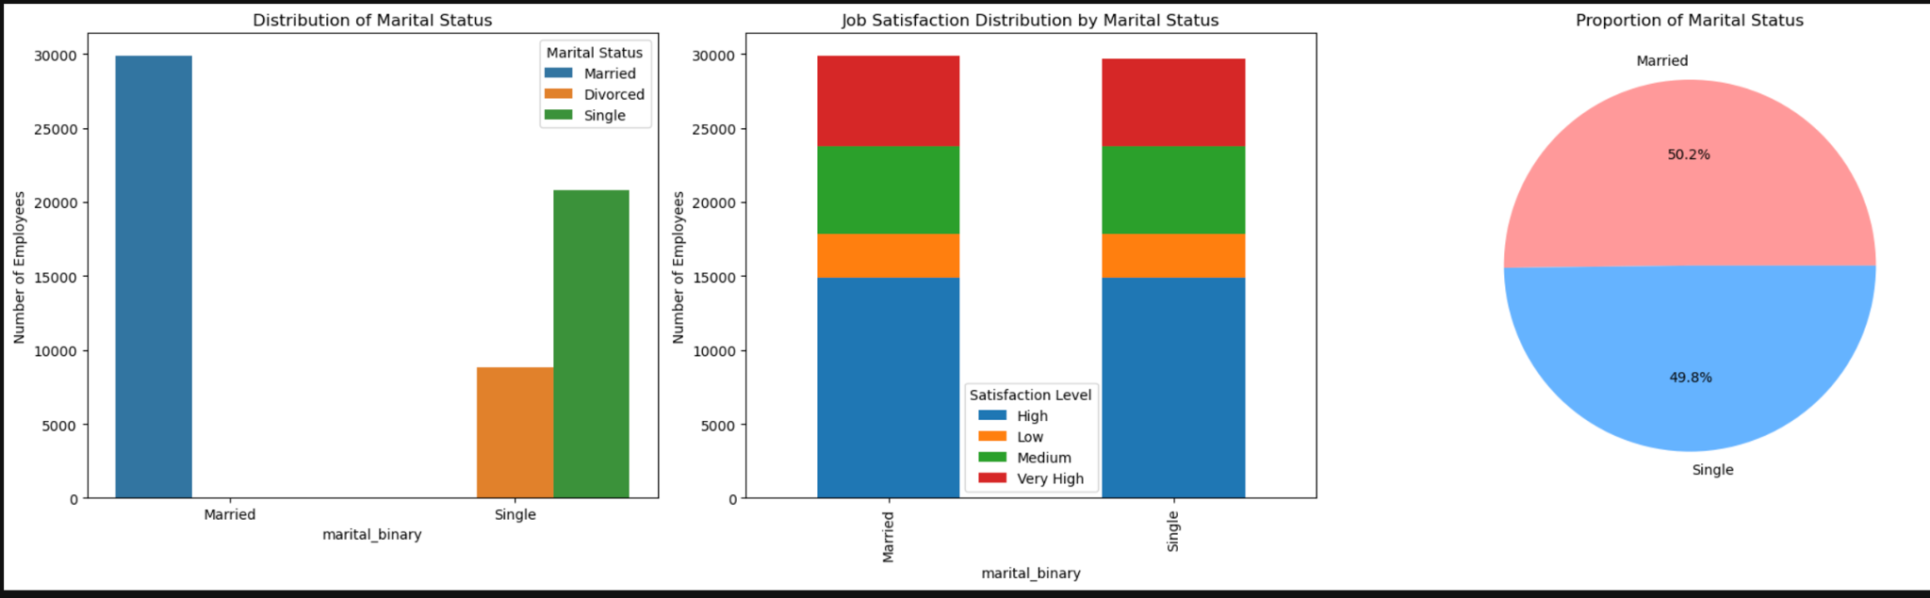
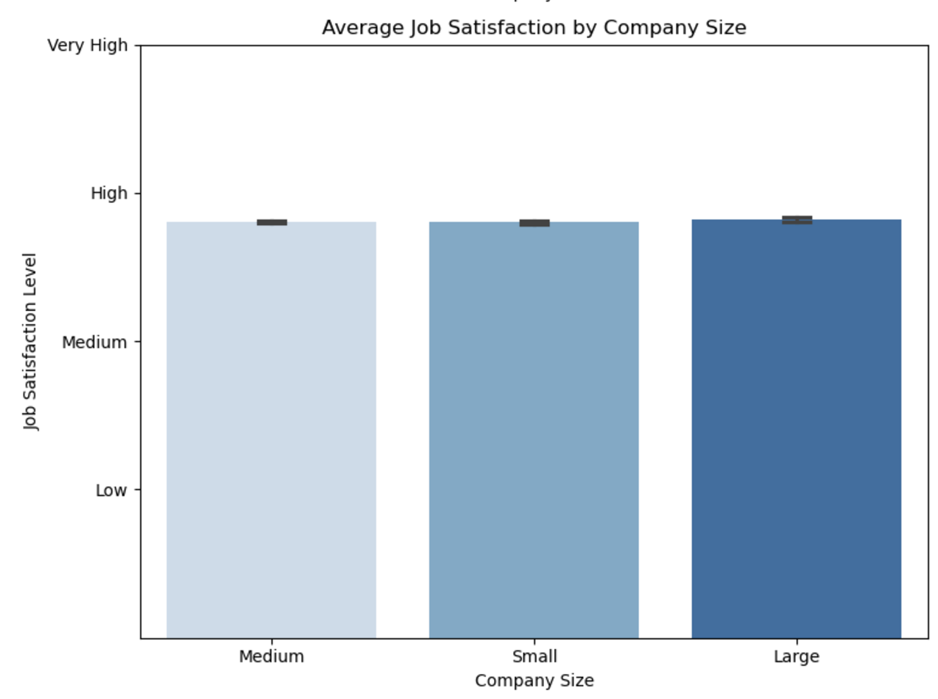
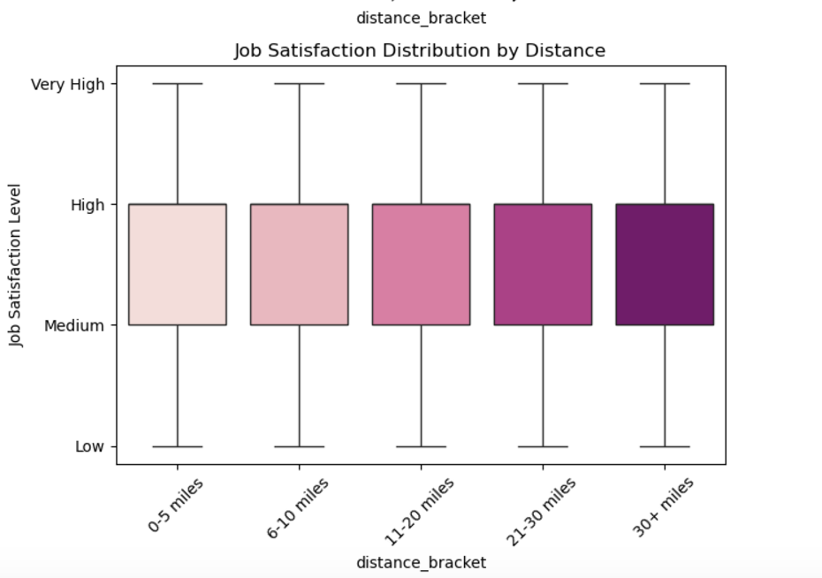
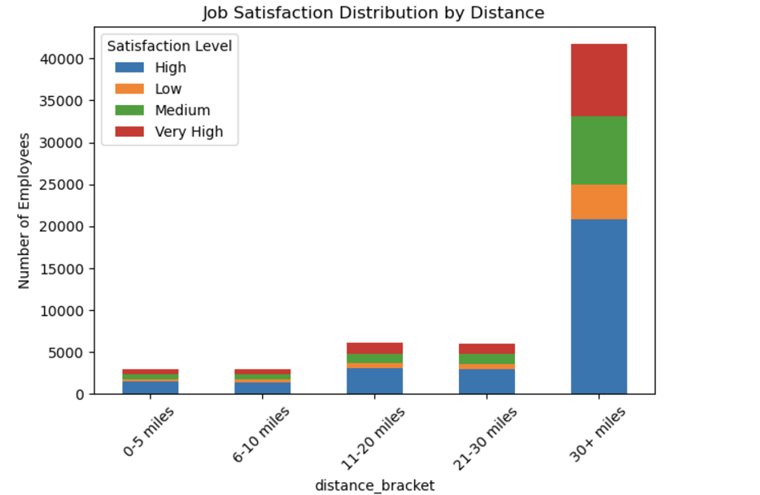
Descriptive Analysis
Company Size
Marital Status
Commute Distance
Consistency is Key
DSO 545 - Cloud 9
EDA Analysis
Page 03 of
Page 5 of 10

Slide 8
Two Sample Tests
Monthly Income
Test Statistic: -2.081
P-Value: 0.0374
Results: P < 0.05
Distance from home
Test Statistic: 0.6297
P-Value: 0.5288
Results: P > 0.05
Build a Network
Build a Network
Reject the null hypothesis, There is statistical evidence that the job satisfaction scores differ between the "high income" and "low income" groups.
Fail to reject the null hypothesis, There is NO statistical evidence that the job satisfaction scores differ between the "short distance from home" group and the "long distance from home" group.
Consistency is Key
Consistency is Key
DSO 545 - Cloud 9
Page 7 of 10
EDA Analysis
Page 03 of
Notes:
Monthly Income
Null H₀: No difference in the mean job satisfaction scores between the "high monthly income" group and the "low monthly income" group.
Alternative H_{a}: There is a difference in the mean job satisfaction scores between the "high monthly income" group and the "low monthly income" group.
Distance from home
Null H₀: No difference in the mean job satisfaction scores between the "short distance from home" group and the "long distance from home" group.
Alternative H_{a}: There is a difference in the mean job satisfaction scores between the "high monthly income" group and the "low monthly income" group.

Slide 9

Statistical Findings
Work-Life
Balance
Company
Size
Marital:
Married
Test Statistic | -0.9976 | 0.7078 | 1.1280
P-Value | 0.3185 | 0.4790 | 0.2593
Chi-square Statistic | 11.4453 | 10.2524 | 3.4282
P-value | 0.2464 | 0.1144 | 0.3302
Result | Not Statistically Significant
Two
Sample
Test
Build a Network
Chi-
Square
Consistency is Key
Two Sample Test
Page 03 of
DSO 545 - Cloud 9
Page 8 of 10
Notes:
We also test Work-Life Balance, Company Size, and Marital Status (Married). Both two-sample tests and chi-square tests were performed. None of the p-values across these tests are below the significance threshold (typically 0.05), indicating that all results are statistically insignificant. This means we do not have enough evidence to suggest a significant association or difference for these variables in the context analyzed.

Slide 10
Further tests
Company Size | Years at Company | Remote Work | Age Group
Small Company None | Low Years None | Yes Remote Chi Square: Company Size | Young Adult None
Medium Company None | Mid Years Two Sample: Monthly Income | No Remote None | Adult None
Large Company None | High Years Chi Square: Work-Life Balance Company Size |  | Middle Age None
 |  |  | Senior None
Filtering data and performing analysis for:
Build a Network
Consistency is Key
DSO 545 - Cloud 9
Page 9 of 10
EDA Analysis
Page 03 of

Slide 11

Conclusion
01
Only monthly income significant…why?
02
Income impacts quality of life
03
Different factors important to different employees
04
More quantitative variables
05
Feature engineering: Adding interaction terms
06
Collecting real-life data
DSO 545 - Cloud 9
DSO 545 - Cloud 9
Page 07 of 07
Page 10 of 10
Notes:
According to our analysis, we concluded that monthly income was the only variable that was significantly positively correlated with levels of job satisfaction. This came as a huge surprise to us, and after we were done with our analysis we decided to take a step back and think about the reasons as to why this would be the case. The first reason is that monthly income directly impacts quality of life and overall life satisfaction. The second reason is that different factors are going to be important to different employees. For example, if one employee values work-life balance as part of their overall job satisfaction significantly more than another employee, it will be very difficult to see a correlation between job satisfaction and work-life balance. In contrast, monthly income is going to be nearly universally important across employees, so obviously it will be much easier to see a correlation.
Since nothing is correlated except for income, but increasing the income might not be feasible for every company, we have some recommendations for modifications that might help improve our dataset for predicting job satisfaction;
Adding other relevant features, e.g. relationship with coworkers
Feature engineering: Leave out some of the most insignificant variables, add more quantitative variables, check for multicollinearity
Adding interaction terms: Marital Status & Work Life Balance
Actually collecting real life data

Slide 12
THANK YOU !

